Slide 1
Topology Based Matrices for Link Prediction
Student’s Name: Bijay Gaudel
Student’s ID: SL1816018
Nanjing University of Aeronautics and Astronautics

Slide 2
Topology Based Matrices
Even in a simple network without node or edge attributes, there are many metrics available for computing the similarity of two nodes.
According to the characteristics of these metrics, they can be divided into neighbor-based metrices, path-based metrices, and random-walk-based metrices.
Nanjing University of Aeronautics and Astronautics

Slide 3
Topology Based Matrices
Neighbor-based matrices
People tend to create new relationships with people that are closer to them.
Researchers design a lot of neighbor-based metrices for link prediction.
Some neighbor based matrices are Common Neighbor (CN), Jaccard Coefficient (JC), Sorenson Index (SI), Adamic-Adar (AA), Resource Allocation (RA)
Nanjing University of Aeronautics and Astronautics

Slide 4
Neighbor-Based Matrices
Common Neighbor (CN):
For two nodes, x and y, the CN is defined as the number of nodes that both x and y have a direct interaction with.
A bigger number of the common neighbors make it easier that a link between x and y will be created
This measure can be calculated by formula
CN(x, y) = |Γ(x) ∩ Γ(y)|.
Nanjing University of Aeronautics and Astronautics

Slide 5
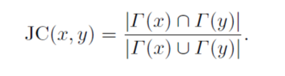
Neighbor-Based Matrices
Jaccard Coefficient (JC):
For two nodes x and y, if there is higher number of common node which shares higher propertion of common neighbor relative to the number of neighbors they have
This measure can be calculated by following formula
Nanjing University of Aeronautics and Astronautics

Slide 6
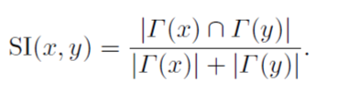
Neighbor-Based matrices
Sorensen Index (SI):
It also points out the lower degree of nodes would have higher link likelihood.
This measure can be calculated by formula
Nanjing University of Aeronautics and Astronautics

Slide 7
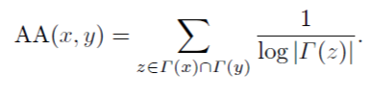
Neighbor-Based matrices
Adamic-Adar (AA):
In this method common neighbors which have fewer neighbors are weighted more heavily.
This measure can be calculated by formula:
Nanjing University of Aeronautics and Astronautics

Slide 8

Neighbor-Based matrices
Resource Allocation (RA):
It has similar form like Adamic-Adar matrices.
It has very close prediction results for the network with small average degrees.
It not only use direct neighbor but also consider neighbors of neighbor
This measure can be calculated by formula:
Nanjing University of Aeronautics and Astronautics

Slide 9
Path Based Matrices
Beside node and neighbor’s information, paths between two nodes can also be used for computing similarities of node pair.
Nanjing University of Aeronautics and Astronautics

Slide 10

Path Based Matrices
Local Path(LP):
Unlike the matrices that only use the information of the nearest neighbors, it exploits some additional information of the neighbors within length 3.
Local Path measures can be calculated by the following formula:
Nanjing University of Aeronautics and Astronautics

Slide 11

Path Based Matrices
Katz:
It is based on the ensemble of all paths, and it counts all the path between two nodes.
Path are exponentially damped by length that can give more weight to the shortest path.
Nanjing University of Aeronautics and Astronautics

Slide 12
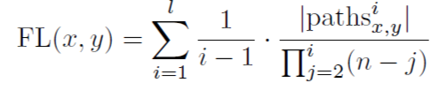
Path Based Matrices
FriendLink (FL):
It is a similarity between node x & y by traversing all paths of a bounded length.
It can provide more accurate and faster link prediction.
Nanjing University of Aeronautics and Astronautics

Slide 13
Random Walk Based Matrices
Interaction between nodes in a social networks can also be modeled by random walk.
Nanjing University of Aeronautics and Astronautics

Slide 14

Random Walk Based Matrices
Hitting Time (HT):
Hitting Time HT(x,w) is the expected number of steps required for a random walk from node x to node w
Formula to calculate hitting time is:
Nanjing University of Aeronautics and Astronautics

Slide 15
Random Walk Based Matrices
Commute Time (CT):
Since the hitting time metric is not symmetric, commute time is used to count the expected steps both from x to y and y to x.
Formula to calculate commute time is:
Nanjing University of Aeronautics and Astronautics

Slide 16

Random Walk Based Matrices
Cosine Similarity Time (CST):
The cosine similarity metric is based on pseudo inverse metrics of L by calculating similarity of two vectors.
Formula to calculate CST is:
Nanjing University of Aeronautics and Astronautics

Slide 17
Thank You
谢谢
Nanjing University of Aeronautics and Astronautics

